Slide 1

Sales and marketing policy
Notes:
10 Mins

Slide 2


ToyBox logo

Slide 3
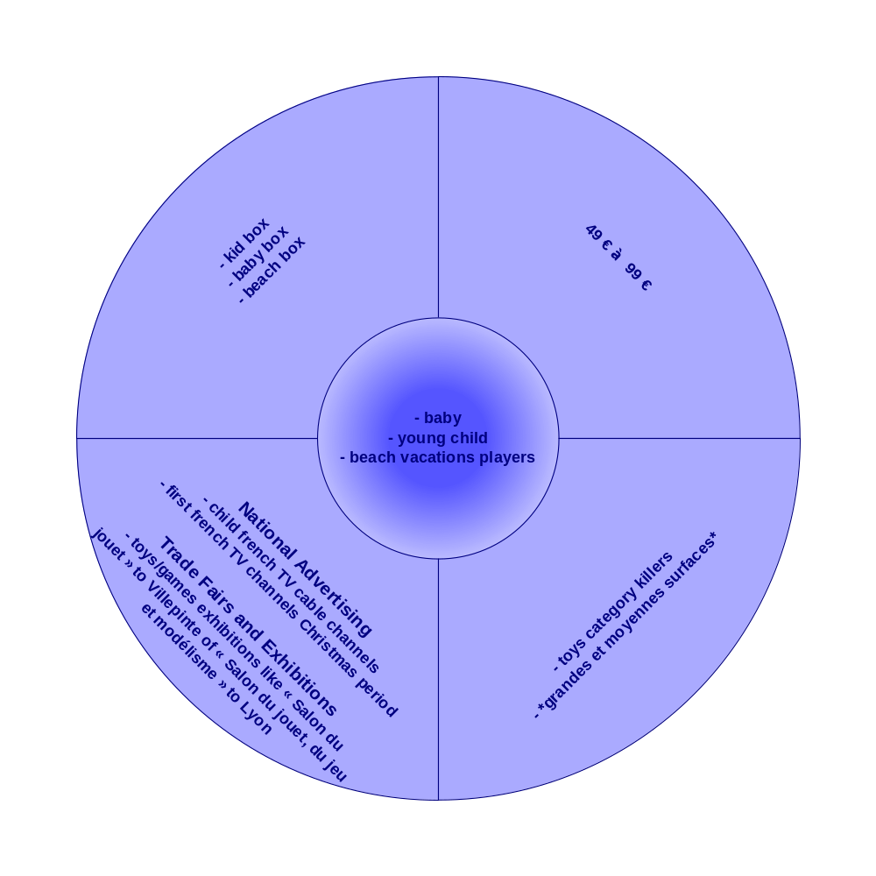
Sells and marketing plan

